Slide 1
Perfect Dependence
Perfect Independence
H(X,Y)
H(X,Y)
H(X) = H(Y)
H(X)
H(Y)
Between dependence and independence
H(X,Y)
H(X|Y)
I(X;Y)
H(Y|X)

Slide 2
Between dependence and independence
H(X,Y)
?
?
?
Between dependence and independence
H(X,Y)
H(X|Y)
I(X;Y)
H(Y|X)

Slide 3
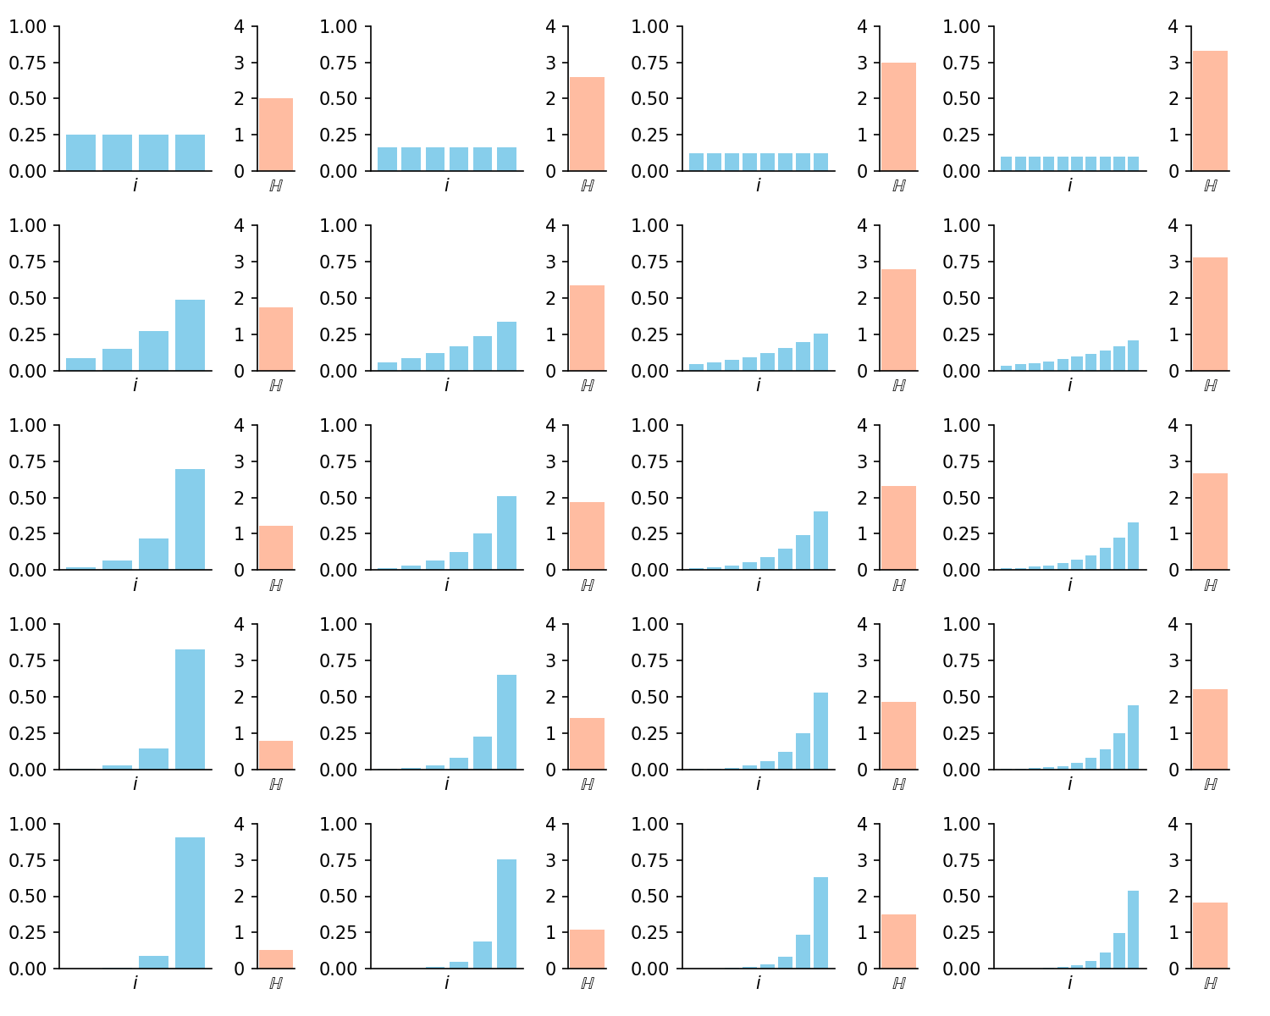
Entropy for varying probability vectors
Decrease probability concetration
Increase number of values X can take

